Slide 1

What brews a winning cup?
What brews a winning cup?
Bryan Larison • Gina Fuller • Alexandra Hagen • Garrett Williford
Group 9 presents

Slide 2

But first, coffee……

Slide 3
Required Packages & Data Prep
01
02
03
Packages
Data Prep
Variables
!pip install scipy
import pandas as pd
import numpy as np
import matplotlib.pyplot as plt
import seaborn as sns
from scipy import stats
Load data & import packages
Inspect and understand the dataset
Handle missing or inconsistent values
Convert and clean numeric fields
Create new cleaned DataFrames for
each research question
Prepare datasets for visualizations
df = pd.read_csv("coffee_ratings.csv")
scores = df_sorted['total_sensory_score’];
corrs = top[attrs].corrwith(top["total_cup_points"]).sort_values(ascending=True);
df['flavor'] = pd.to_numeric(df['flavor'], errors='coerce');

Slide 4
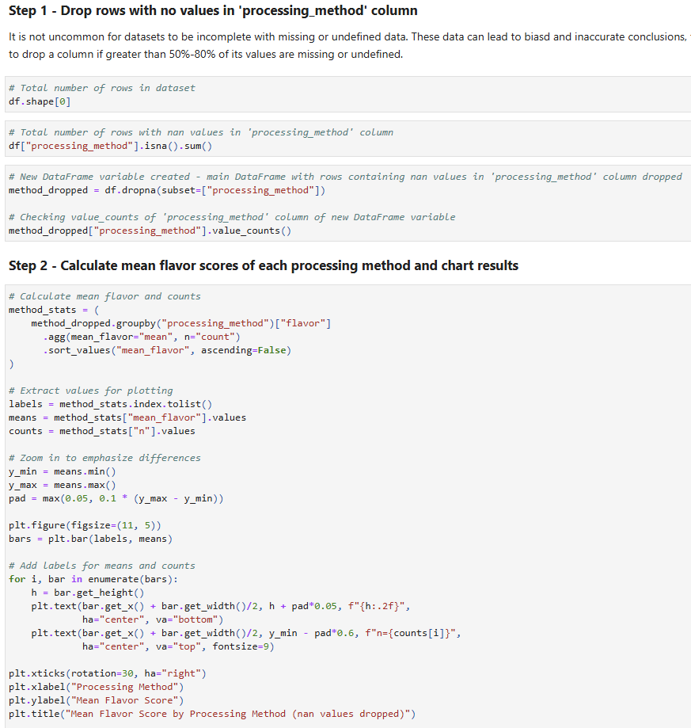
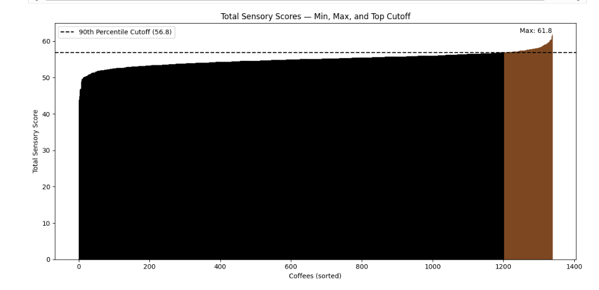
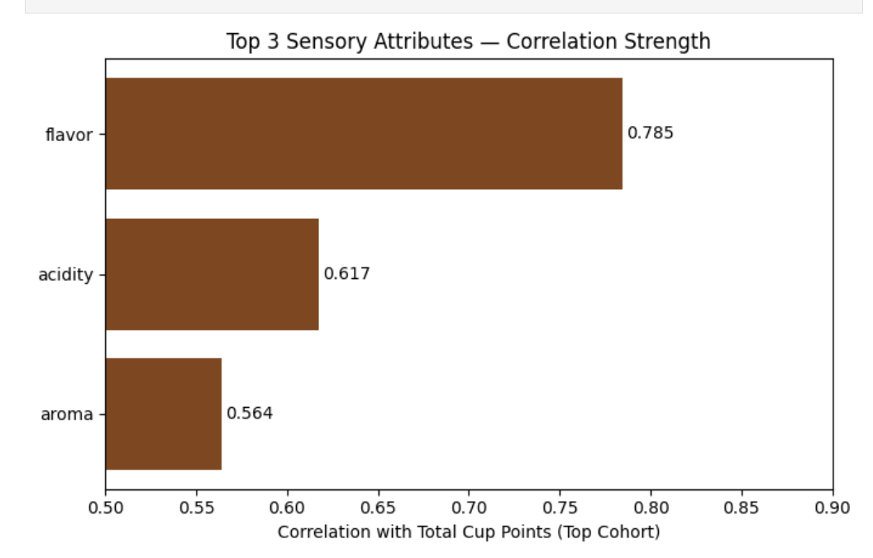
Which processing method scores highest in flavor?

Slide 5
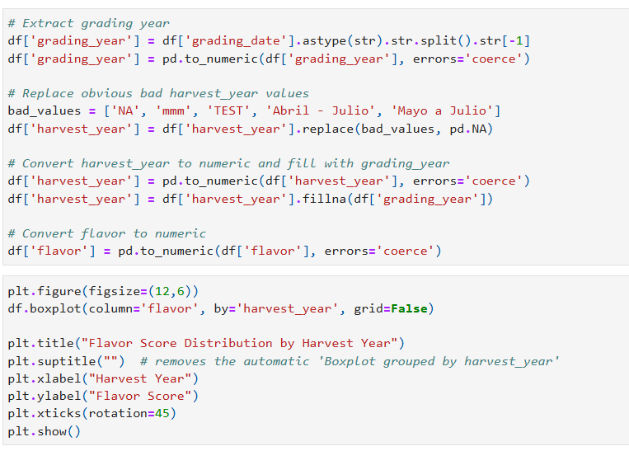
How have average coffee flavor scores changed across different harvest years?
Extracted grading year from grading_date for consistency.
Cleaned harvest year from bad values.
Replaced missing harvest year value with grading date year.
Converted flavor scores to numeric values for accuracy
Built boxplot with pandas

Slide 6
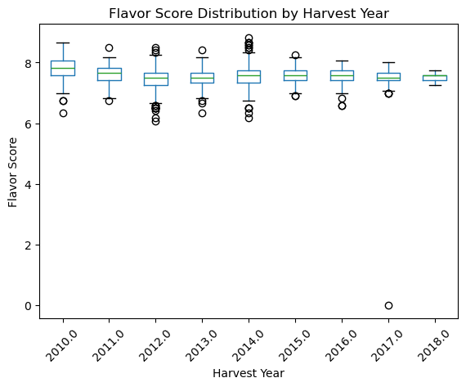
Outliers more common in early years, with
occasional exception.
Flavor scores becoming more stable and consistent as time goes on.
Reliable coffee flavor across brands.

Slide 7
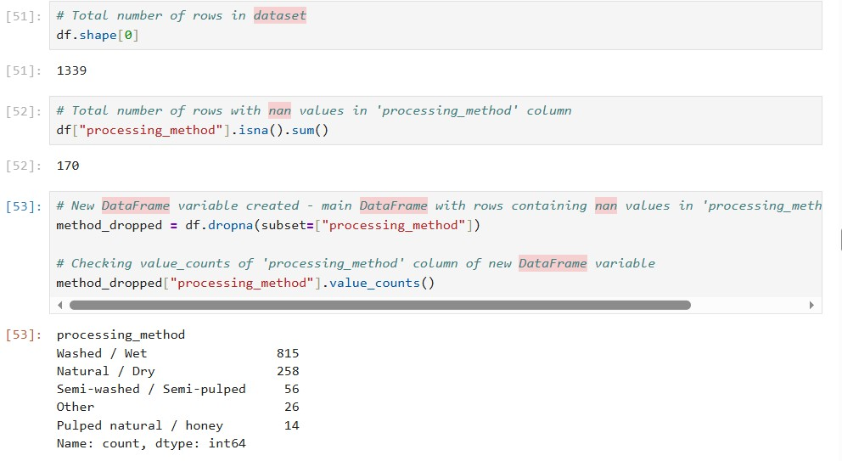
Which processing method scores highest in flavor?
Determined that rows with nan values needed to be dropped
Created a new DataFrame with cleaned ‘processing_method’ column

Slide 8
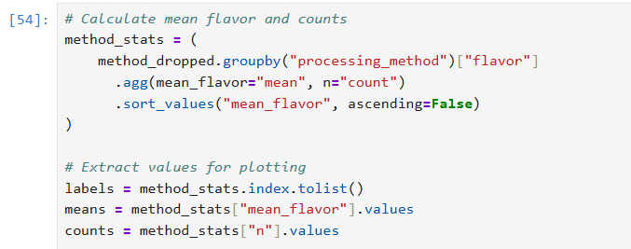
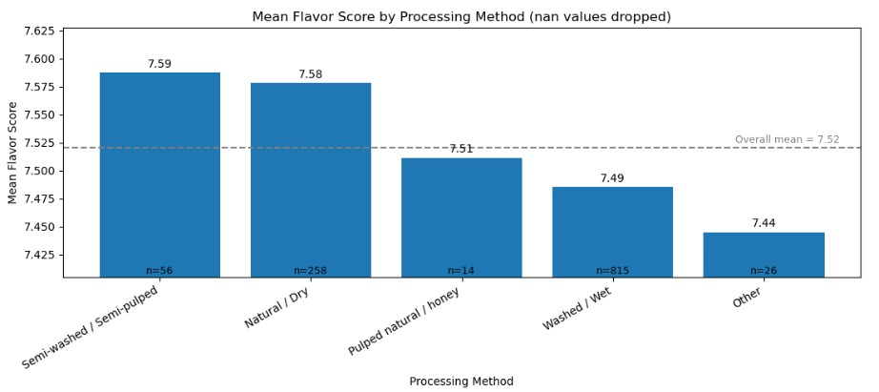
Calculated mean flavor and counts
of each processing method.
Created a bar chart of the calculated data

Slide 9
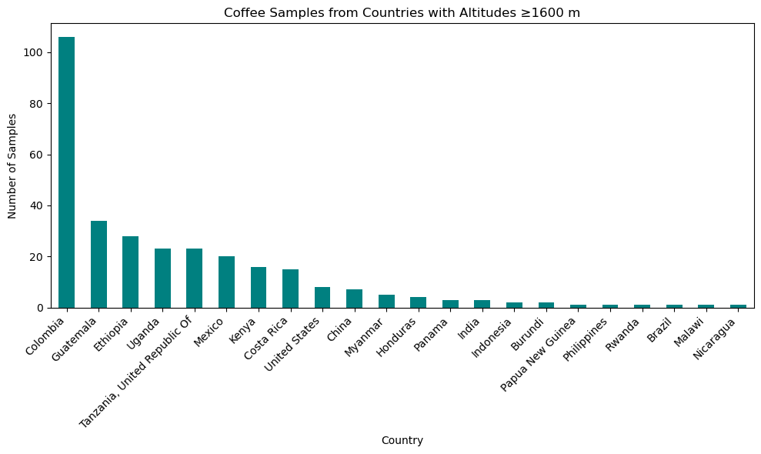
What is the relationship between a coffee’s country of origin, the altitude where it is grown, and its flavor score?
Coffee samples plotted across number of samples by country
Colombia stands out with an abnormal number of samples that occur over 1600 meters

Slide 10
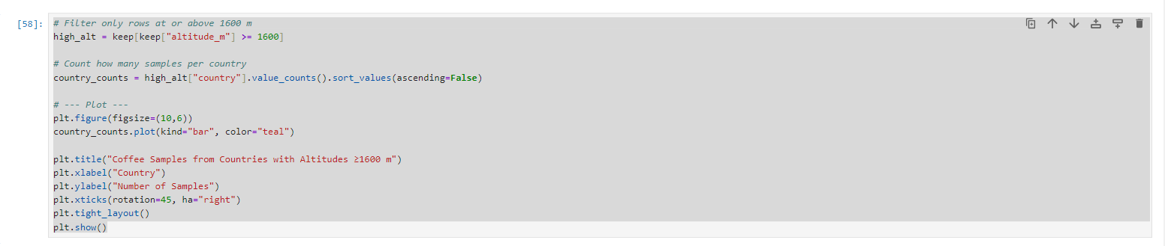
Filters data to only include countries with altitude equal to or greater than 1600
Plots count into simple bar chart with respective titles and
labels

Slide 11
Results & Conclusion
Top coffees are clearly distinguishable, with total sensory scores ≥56.8 defining the elite tier.
Flavor is the strongest predictor of overall cup quality, outperforming other sensory attributes.
Flavor scores have grown more consistent over time, reflecting improved cultivation and grading practices.
Semi-washed and natural dry processing produce the highest average flavor scores, suggesting minimal-intervention methods preserve flavor best.
High-altitude coffees (≥1600m) consistently score higher, confirming altitude as a major quality driver.
Country-level differences are largely explained by altitude, with high-elevation regions dominating top-score distributions.
Overall, flavor, altitude, and processing style are the key forces that elevate coffees into the top tier of quality.

